Slide 1
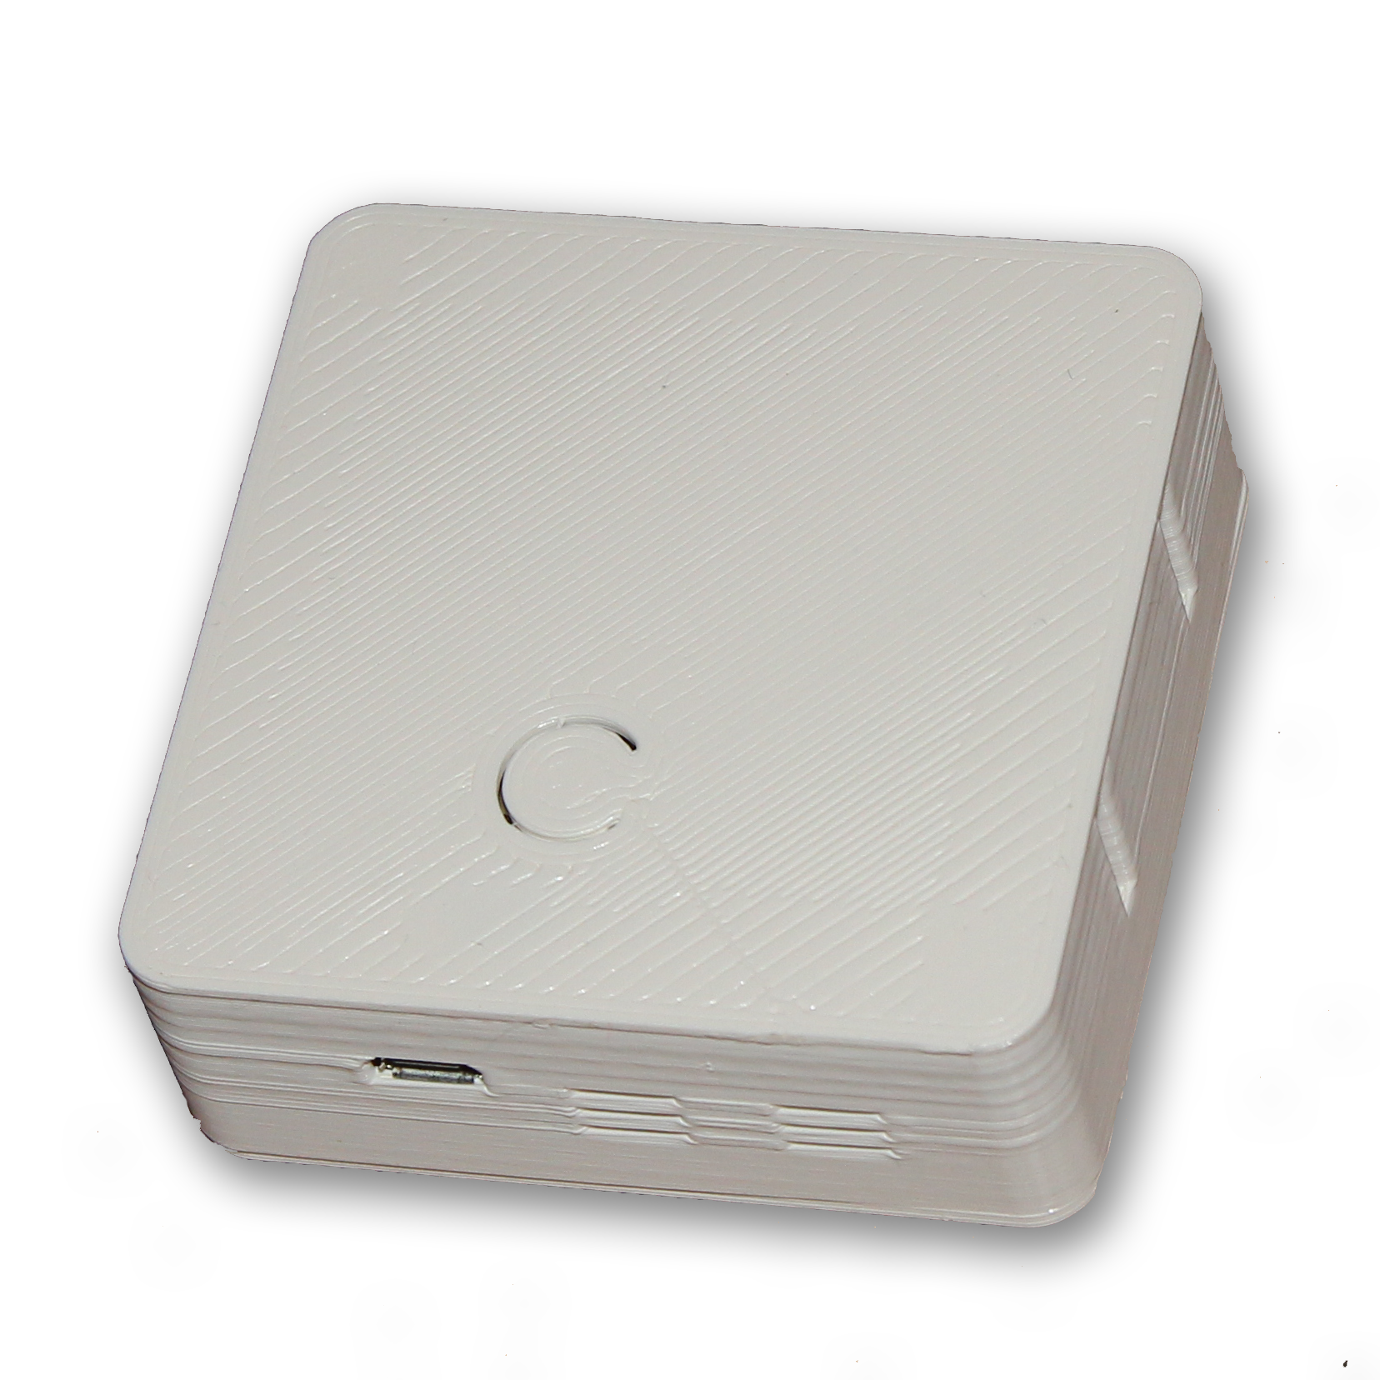
vThings – CO2 Monitor v3
NDIR CO2 Sensor
Wi-Fi Connectivity (HTTP/MQTT)
Optional RF 433 MHz
Customizable Firmware
CO2 Sensor Upgrades
No Calibration
Up to 10,000 PPM
Higher accuracy
Low Power
More Sensors
Dust 0-1000 um3
Temperature
Humidity
Pressure

Slide 2
vThings – CO2 Monitor v3
Lot’s of customizations

